Slide 1
WheelO’Lunch
CS 275: Web & Mobile App Development
Steve Calabro
Bruce Johnson
Benjamin Greenfield

Slide 2
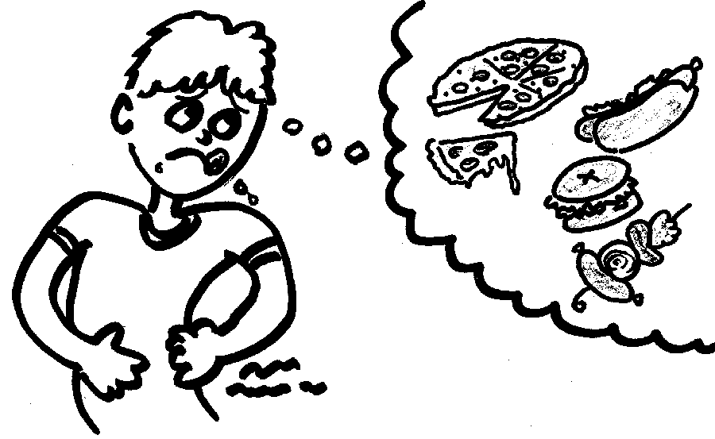
Have You Ever…
Been hungry, but couldn’t decide what or where to eat because
There were too many options,
You weren’t familiar with local
places to eat, or
You just wanted to try
something new?

Slide 3


If so...
WheelO’Lunch to the Rescue!
=

Slide 4

Why It’s Necessary
Thousands of lunch choices
People can be indecisive
Opens people up to trying new things
Makes choosing a lunch place sociable & like a game
Helps promote places that are
high quality

Slide 5






Resources/Tools
Git/Github
Android ADT
Facebook
Weather
Maps
CloudMine

Slide 6
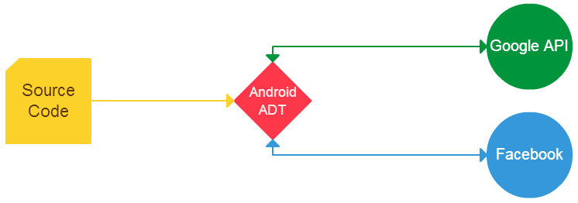
Design Diagram
Cloudmine

Slide 7
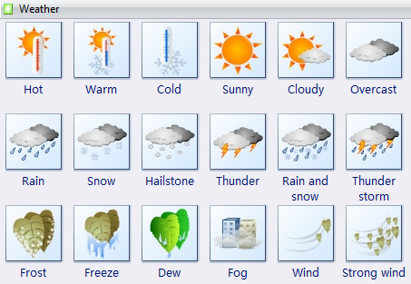
Weather Algorithm
Takes into account
Temperature
Wind
Humidity
Precipitation
Algorithm used to predict
preferred walking
distances

Slide 8
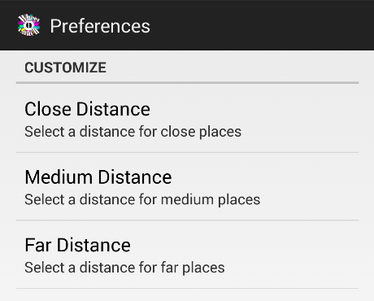
Distance
Distances labeled as close, medium, & far
User can set distance preferences

Slide 9
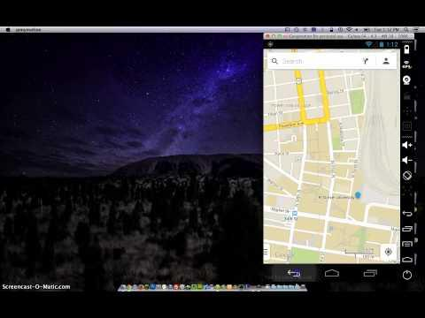
Screencast
-Live

Slide 10
Improvements
Fix Facebook Login bug
Add ability for users to add place
Change graphics/styles
Improve weather algorithm by adding complexity
Add filters
Add google places api
More At
https://github.com/steveacalabro/WheelOLunch/issues

Slide 11

Division of Labor
Equal labor
Public GitHub repository

Slide 12
Questions?

Slide 13
Thank You!

